Slide 1
Machine Learning Applications in Performance Analysis
Gopal Brugalette
Performance Architect
SoFi
Find me on LinkedIn

Slide 2
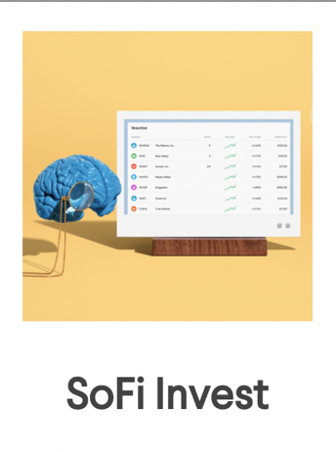
$30 billion in funded loans
1 Million members and counting
98% would recommend SoFi to a friend
Notes:
SoFi helps people achieve financial independence to realize their ambitions. Our products for borrowing, saving, spending, investing, and protecting give our more than half a million members fast access to tools to get their money right.

Slide 3
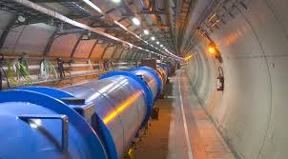
Gopal Brugalette Performance Architect
Notes:
iI've been doing performance engineering for over 15 years. This includes working with financial instituions, e-commerce and SAAS providers. When I think I about performance engineering, it's really about data analysis, taking all those metrics like response times, CPU and memory utlilization and summarinzing them into information, and from that infrmation information , deriving insights about the customer experience and the health of our systems. then taking the appropriate action to improve that or resolve any issues. Thie sprocess of taking data to information to inshgts to action that’s what makes me think of performance engineering as a data science. Th typical way we anlayze that data and information is using dashboards and maybe setting alerts, But that just doesn’t scale anymore. We can’t just going creating 100’s of dashboards. We really need a better way to appraoch this.. WE can apply machine learning, a tools of data science to do just that . Machine learning is really just the math that enables computers to do some of the analysis we do as performance engineers. In this presentation, I’m going to introduce you to 3 common machine learning algorithms: Regression Analysis, clustering and Neural Networks. I’ll show you how they work and how to apply them to different use cases in analyzing performance data. This will be a great starting off point for you to further explore machine learning on your own.

Slide 4
Use Case 1: Monitoring Customer Experience
Goal: Build a Model to understand customer experience.
KPI Metrics - Features
CPU
Memory
Response Time
User Load (counts)
Feature Engineering
Understand your data
Find dimensions or features
How are they related?
Notes:
So in our first use case, we want to build a machine learning model to better understand the customer experience. WE start with what’s called feature engineering, we first have to understand what data we have and what it tells us about our goal, or what we want to predict. In performance we have a lot of metrics like …and we need to understand how they are related. One of The best metrics to understand custoemr xpreince is going to be response time. What is the independent variable or feature that tends to drive that reponse time of our sytem, very often it’s going to be user load, the number of the users on the system. And in fact, it tends to drive all the other metrics. So it’s a really good starting point when looking for a feature.

Slide 5
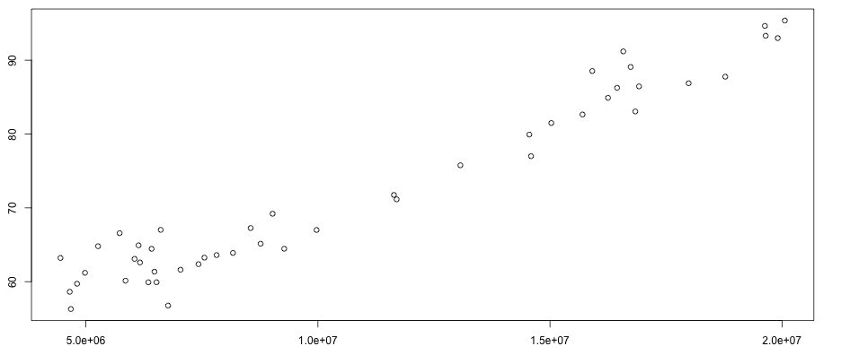
Response times vs user load
Response Time (ms)
Load (Count)
Notes:
So the first thing we do is graph response time vs user load, now this is acutally real data from a system I worked on. And here we can see that I can pretty much draw a line right through the data points on this graph. This means there is a linear relationship between response time and load. Now in other use cases, tis might not be so obvious, but you can use mathematical techniques to evaluate how well the data fits a line but we won’t go into those now. But here we clearly can make use of a linear model.

Slide 6
A little math
Response time = f(Load)
A linear model fits the data
y = a + bx
Examples
x | y=x | y=2x | y=3+2x
0 | 0 | 0 | 3
1 | 1 | 2 | 5
2 | 2 | 4 | 7
3 | 3 | 6 | 9
4 | 4 | 8 | 11
5 | 5 | 10 | 13
Notes:
Coefficent and constant
So now we are going to do a little math. Mathematically, we can express our model as saying responstime time is a function of load. And that function as we say early is a line. The way to mathemetically express a line is here, y= a +bx, a is a constant and b is the coefficent. Y is our response time and x is our load. Here we can see various examples of how varying those values affects what the line looks like. We are bqscailly changing it’s intercept (a) and slope (b). And so this is the equation of line, and what our model is going to look like.

Slide 7
A little more math
Response time = f(Load)
A linear model fits the data
y = a + bx
Load is x, Response time is y
Solve for a and b
$a=\frac{\left(\sum{y}\right)\left(\sum{x^{2}}\right)−\left(\sum{x}\right)\left(\sum{xy}\right)}{n\left(\sum{x^{2}}\right)−{(\sum{x})}^{2}}$
$b=\frac{n\left(\sum{xy}\right)−\left(\sum{x}\right)\left(\sum{y}\right)}{n\left(\sum{x^{2}}\right)−{(\sum{x})}^{2}}$
Response time = constant + coefficient * Load
This is Linear Regression
Notes:
So really what we need to do is solve for a and b. X is our load, y is our response time. Each point of our data set, (or training set) is a pair of these values.for any value of load, we have a response time . We solve for a and b, using this formula. And this process is called linear regression. Now this formula might look a little complicated, but you don’t have to actually do this on your own

Slide 8
A little code
Train the models
Make a prediction
Notes:
Because the great thing is, many languages have this calculation built right into them. In this example I’m using a data science language called R, but you might also do it in a lnaugage like Python, or even excel. So in line 202, you see I call the function lm() with some paramaters. LM is linear model, so it does all those calculations we saw before for me. I’m bascially telling it to build a linear model for response time using count, and what data set to use to calculate a and b. from 199 to 203 I’m acutally looping though to create or train multiple models, for different response time percentiles, , like the p25, p50, p95 etc. We’ll see more of that later.
Then once I have my model, I want to use it to make a prediction, or given a parcitucalr count, what would my m odel, or equation tell me the response time should be. So we’ve essentially built a machine learning model to predict response times, using linear regression And we’ll see how to put this to use in a few slides. So that’s the math and code, what does this actually look like actually in process?

Slide 9
WorkFlow
Identify training data
Extract Training Set
Evaluate models
Deploy to EC2
[R code]
Train models
[R code]
Train the Models
Logs/
Monitor
Endpoints
(csv)
API
Realtime monitoring data
Evaluate monitor vs prediction
Output monitor and prediction to file
Send to ES via Logstash
Run monitoring
Notes:
So here’s what the actual workflow looks like to use this machine learning model. First have I indetify the training data in the APM or monitoring tool, I want to make sure I don’t use a day that has an outage or something weird happenning. Then I extract the data using the API,. And I’m doing this for a number of endpoints, because I want to monitor the performance of all my key endpoints, all the business critical ones that really affect the customer experience. And now you start to see the one of benefits of or the power of machine learning, I can do this automated analysis monitoring for any number of endpoints.
And then I run the monitoring – and here’s what it looks like
ES for visualization purposes
Manually Evaluate days for training data
CSV of all endpoints
Extract Training Data via NR API
Train models
Evaluate models for fit
Deploy to EC2

Slide 10
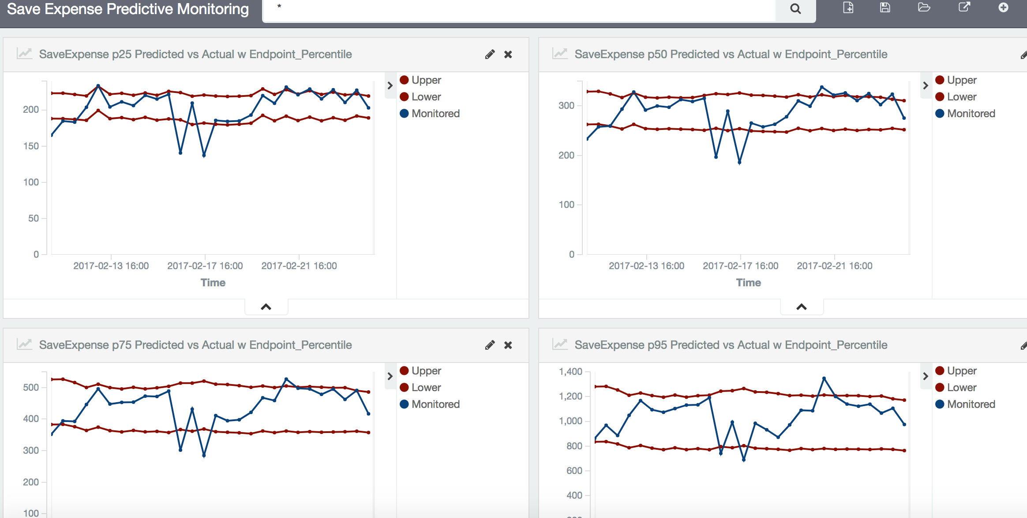
Predictive Modeling of Response Times
Model predicts response times (red) based on measured load and compares it to monitored [actual] response times (blue).
Notes:
Here is a visualization of how we are analyzing the performance with our model. Remember, what I’m doing is taking the load, as measured by my monitoring tool, and feeding that into my model. The model then makes a prediction about what the response time of that endpoint should be. The model also gives an upper and lower bound for the predicted value. Those bounds are plotted as the red lines. There’s always variance in the data, and giving these bounds helps account for it. By making it a little less precise, It makes the model more accurate and useful.In blue, I’m plotting the actual value of the response time, for that given load, at that time, as measured by the monitoring tool. When the actual value goes beyond the the red lines, or predicted values, I could have a potential problem. The system isn't performing as it would be expected to, as predicted by the model. IN these graphs, we see a models for 4 different percentiles of the response time distribution). I always like to look at the different quantiles, as you can get more insight than just looking at the average. What makes this regression model based analysis very useful, it's only based on the load, and that's important . The load on a system varies throughout the day, month, year, but this model can still make accurate predictions, based on that ever changing load. And that lends itself to a number of use cases.

Slide 11
Predictive Modeling of Response Times
Read production load
Model makes response time prediction
Compare actual response time to model
Investigate variances
Notes:
The way this works is
I read in the real time production load via a monitoring tool and then I make a prediction on what the response time should be , based on that load. I do this of course, using my trained model.. I’m plotting the upper and lower bounds of that prediction in red. I’m also reading in the actual production response time, as measured by the monitoring tool and plotting that in blue. Then I can compare the actual value in blue, to see if it’s withing the bound spredicted by the model, in red. When the blue line, the actual value, is within the red lines, I know that the system is performaing in accordance with how my model predicts it should. That means everything is Ok. When it goes out of bounds, something has happened. Either there is a problem with my system, or there is a problem with my model. IN either case, I need to investigate what has happened.

Slide 12
This is Machine Learning
The predictions are completely dynamic, based on the ever changing load on the system.
Notes:
Now the really important point to understand here is this whole process is dynamic, as the load on the system tchanges hrough the normal course of bussines during the day, the model automacially adapts and makes the correct predictions for that changing load. That’s what makes it machine learning. If all of sudden, a lot of people come on to the site. maybe ther eis a big sale or add campaign, or the business naturally has a peak every evening at 6pm ithe model still can make an accurate prediction and determine if the system is performing properly. That’s very powerful. And that lends itself to a number of use cases.

Slide 13
Evaluate Production Changes
Challenge:
Deploy code off-hours
Test site with low load
It works!
Peak load comes
It fails!
Solution:
The machine learning model evaluates performance metrics under low load to check for changes in the characteristics
Notes:
The first use case is to evaluate production changes
A common situation is a team will deploy code to production during off hours, and then they go and test it, and everything works and performs well, but the site is under low load, it’s off hours. Then the next day, or later in the week, the peak load happens. But under this high load, the system fails., the performance is terrible, This scenario occurs because it can be very difficult to detect performance changes when the site is under low load. Everything looked fine. It only become obvious when the site is under heavy load that there is a problem
The type of machine learning model we showed can be used in these sitauations. It dynacmically compares the actual current performance to the predicted performance. If you trained the model the on the previous version of the code, it can compare the new code’s performance in production to the previous version. And it can do it no matter what the load. So it can detect if a system is performing worse on the new version of the code, then it would have been performing on the old version of the code, given the same load.. This can potentially help you predict and detect major issues before they occur

Slide 14
Less than optimal performance
Predicted vs Actual Response Times
250
200
150
100
50
Response time (ms)
06:00 09:00 12:00 15:00 18:00 21:00 24:00
The model detects that the system is slower than predicted, given the load
This occurs every day at 6:00 pm
Notes:
The next use case is to detect less than optimal performance. I was running the model to monitor a production site when I noticed that every day at 6pm, the site was slower than the model predicted. It wasn’t very much, juat 50 or 100 ms, This type of deviation wouldn’t typically be noticeably to the normal type of production monitoring based on SLA thresholds. It’s too small. It’s not a major issue. But the model had a much greater precision and could detect small changes. And this increase could impact the user experience. When I did some investigation, I found out that there was a batch job kicking off every day at 6pm, and it was causing a small slowdown. Now it may not seem like much, but in ecommerce, milliseconds are money, and this detected that the system was performing less than optimal.

Slide 15
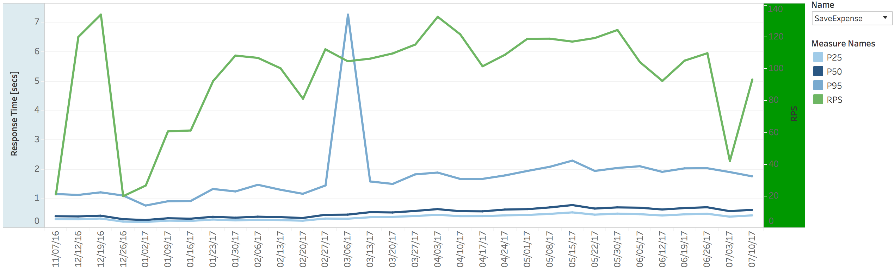
Normalize for Load
Compare the performance of different loads for different versions of the code over time
Notes:
The third use case is trending over time for different load profiles. For systems that have performance dependent on load, it can be diffcilut to determine if the observed change in performance is due to a change in load, or something else, like a code or infrastrcutre change. I’ve had many discussions with developers over this issue, The question is is the code getting slower, or is it just the increasing load using more resources and causing things to slow down? Well, Using the model, we can compare the performance of system under different loads and dtermine if it is still performing to the predicted values or not. Essentially, we can normalize the performance for different loads and compare them to each other.

Slide 16
Detecting Outages
Predicted vs Actual Response Times
300
250
200
150
100
50
Response time (ms)
06:00 09:00 12:00 15:00 18:00 21:00 24:00
A severe variance from the model predictions could indicate an outage
Notes:
And a final use case is to use the model to detect outages or severe problems in the system. If there is a very large variance from the predicted values, there’s probably something going on. But there are better, easier, ways to detect outages.

Slide 17
ML Use Case 2: Managing servers
Server Tier/Application Performance
Large numbers of “Identical” servers
Should perform the same
Sometimes they don’t
Hard to See
Statistics hide Issues
Too many metrics to track
Errant servers missed
Affected customers have bad experience
Use case for unsupervised learning Clustering
Notes:
Now we are going to talk about our next machine learning use case. We usually have a large number of servers, or server farm, running to support an application or service. There could be hundereds of servers, and in theory, all these servers should be performing the same. But sometimes they aren’t. And it can be hard to find the few that are acting differently. It can be in any of metrics or symptons that we would have to look at to detect an issue. Our Typical statistics would show that things are normal. But customers are on those errant servers, they’re not gonna get the best experience. So in this case, where we aren’t sure what to look for, and don’t have a great set of historical data to compare with, we can use what’s called unsupervised learning

Slide 18
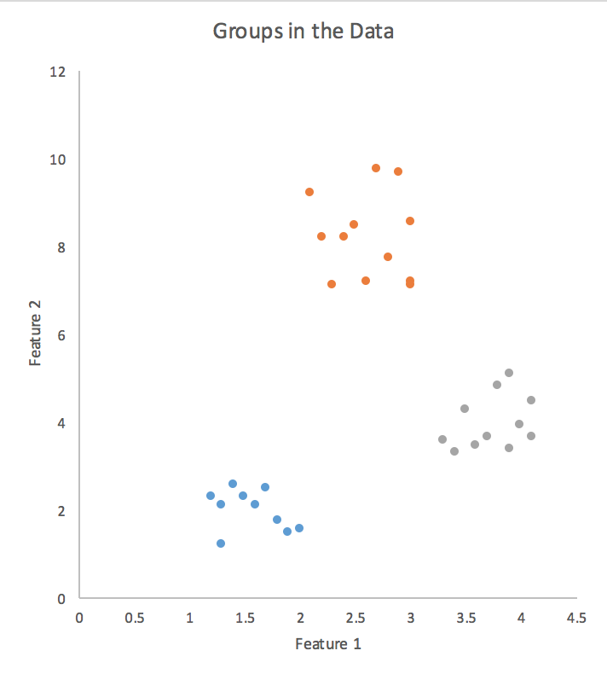
Clustering
Kmeans Clustering
Unsupervised
Segments data by similarity of features into K number of groups
Algorithm
Select center for each of K groups (centroid)
Assign each point to nearest centroid
Calculate new center as mean of points in the centroid
Iterate
Notes:
And here we are gonna use K-means clustering . IT segments data into k number of groups, based on feature similiarty.
Its starts by slecting a center for each of the K groups, or centroids. Then each point is assigned to the nearest group. Then a new center is calculated as the average, or mean of all the points in the group. The nit iterates, reassigning the points to the nearest center. It iterates until the groups are identified.
Now we’ll look at an example of how to apply it in practice.

Slide 19
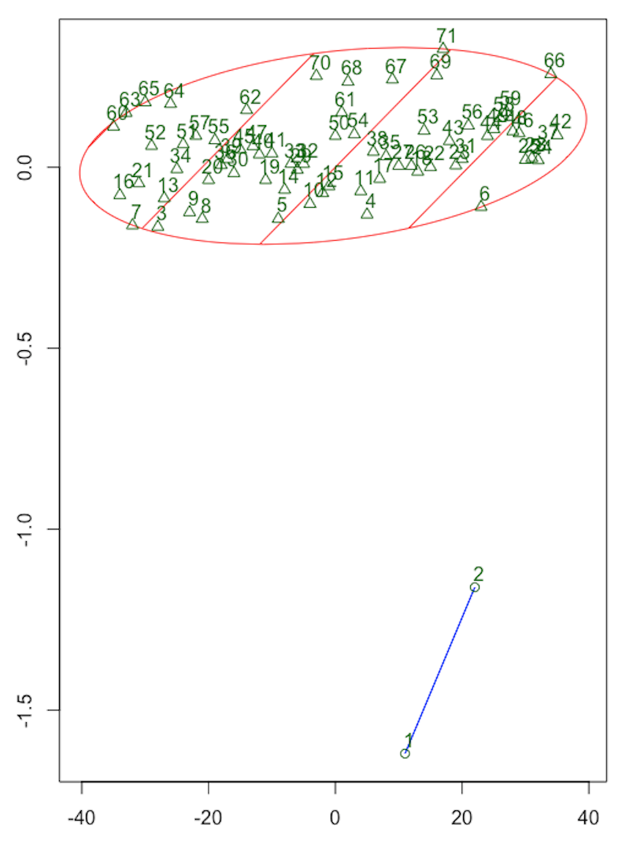
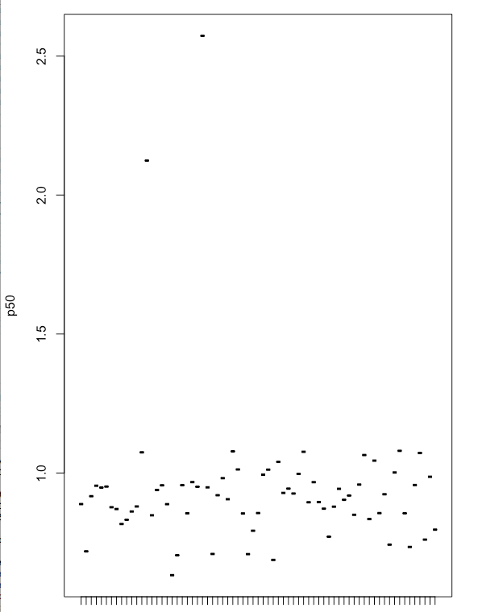
KMeans Clustering of server performance
P50 Difference
Server Index(ID)
Lines represent a server
Server Index(ID)
Automatically finds different groups
Notes:
So here I analyzed the response time data for each server in the tier by using kmeans clustering. I took the median response time for each server, in 5 minute intervals, and clustered them. You can see on the left that the algorithm divided the data into 2 different groups. In the middle is a visualization of the data in that time slice, and on the right, you can see what the data looked like graphed in a monitoring tool. It’s very clear that two of the ervers are performing 1- 2 seconds slower than the other 80 or so. Now remember, I could apply this machine laerning analysis to any number of server groups and any number of metrics. And I’ll I’m doing is syaing, look for servers that are different. I don’t have to go and set a lot of arbitray thresholds,and I don’t have to look at a hundred dashboards. So this is very dynamic and scalable, a benefit of applying machine learning to this problem. I can find a lot of things other than just failures and outages. In this case, working with operations, we found out that those two servers had a bios setting for energy saver on – they were using less electricyt, but running slower. So that means about 2 percent of our customers, were getting a slower than optimal experience.

Slide 20
A little code
17 Read the data
18 Clean it up
19 Execute Kmeans for K=2
20 Print it out
Notes:
And here’s some basic code in R to do this analysis. It just reads in data, in this case a csv file, although it could easily be a real time api call, cleans it up a little and then performs the clustering analysis and prints out the clusters.

Slide 21
How many clusters?
hierarchical clustering
Elbow Method
2
3
Various Calculated Methods
Libraries do it for you
Notes:
There’s always a challenge with using clustering and that’s determining what the optimal number of clusters should be. There’s a few ways to arrive at that, both manually, suing hieracrhcically clustering, where you draw a horizaontal al line through the vertical ones . And there’s other ways, using libraries, to calculate it as well.

Slide 22
The hard parts
Pick an algorithm & model
Feature engineering
Data wrangling
Training set
Productionizing
Notes:
So we looked at an example of supervised machine learning in lieanr regression, where we trainined the model with a set of data, we looked at unsupervised learning, in clustering, where there was no training of the model. There are lot of different machine learning algorithms, and one of the hardest parts is pikcing the right one for your problem. Then you have to determine which are the best features or metrics to use and that can be an iterative process. Data wrangling, or getting the data,cleaning it up and getting it into the right format you can use it, can also be non-trivial. Then you have to make sure you have a good training set of data for your model, and finally getting it to run in production is more soaftware engineering than data science, but important as well.

