Slide 1
Migrating a Recommendation System to Cloud
Using ML Workflow
Dheeraj Chahal, Ravi Ojha, Sharod Roy Choudhury, Manoj Nambiar
TCS Research
ICPE 2020 Virtual Conference
April 20 - 24, 2020

Slide 2
Outline
Motivation and Problem statement
Our Recommendation System
Migration Strategy
Results
Conclusion

Slide 3
Motivation
Recommendation systems improve customer experience
Retail
Hospitality
Media

Slide 4
Motivation
Migration of recommendation system to cloud has multiple advantages
Scalability on demand
Easy deployment using frameworks
Cost effective
CLOUD
Location and device independence
Multi-tenancy

Slide 5
Motivation
The chosen instance or cloud service should provide low-latency and cost-effective inference
Model training
Model deployment
Max
Min
Model inference
Performance
Cost
Min
Max

Slide 6
Objective
Migration methodology for a recommendation system to migrate from on-premise deployment to cloud using AWS ML workflow called Sagemaker
Recommendations for performance and cost-effective deployment of recommendation systems
On Premise
Cloud

Slide 7
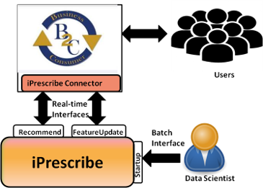
iPrescribe
Prescriptive Analytics like ‘what shall I do’ to engage customers in B2C systems using recommendations and/or campaigns
Scales to Millions of product recommendations.
User actions applied on model to decide offers.
Optimizations in XGBoost and LSTM algorithms implementations to reduce model inference time.​​

Slide 8
iPrescribe Framework
Real time processing
Batch processing
Tx message
Messaging
Layer
Persistent data store
Persistent
layer
iPrescribe connector
Messaging layer
Tx history
Processing
Layer
Feature Update
Recommend interface
Start up interface
Update entity features
HTTP REST api
Update entity features
Deploy model
In memory data store
Model inference framework
In-Memory Layer

Slide 9
iPrescribe using AWS Sagemaker
MXNet and SAGEMAKER FUNCTIONS
USER IMPLEMENTED SAGEMAKER FUNCTIONS
MXnet()
Estimator-script, instances, hyperparameter role,credentials
train()
Model training
Fit()
Pass training data locations
save()
Saving model
deploy()
Starts server, initiates workers
model_fn()
Loads and deploys models
prediction(data)
Data for prediction ( from web ?, batch)
Transform_fn()
fomattiing data, prediction module, output
delete end_point(data)
Delete instances and model

Slide 10
iPrescribe vs Sagemaker workload
Native iPrescribe
Sagemaker implementation
File
File
File
File (Batch)
Producers
Producers
Producers
Producers
Producers
Producers
Virtual Machine -1
HAPROXY
NGINX
Consumers
Consumers
Consumers
Consumers
Consumers
Consumers
CLIENT + SERVER
Virtual Machine - 2

Slide 11
Implementation workflow
S3
Sagemaker
Jupyter Notebook
Batch transform job
Or
http request
Training data
Trained model
Training job
Prediction request
Endpoint
Prediction result
VM-2
VM-1

Slide 12
Inference
Deployed Model
HTTP Request /invocations
CLI, java , Python
Batch job
Multiple inferences
Python/java
Inference request
Inference request

Slide 13
Experimental Setup
Two well know benchmarks used
- PAKDD
- InstaCart
On-premise and AWS deployment of iPrescribe
c-family and m-family instances of AWS for cloud experiments
Load generated using HTTP requests and Batch jobs
Batch mode requests were read from files.

Slide 14
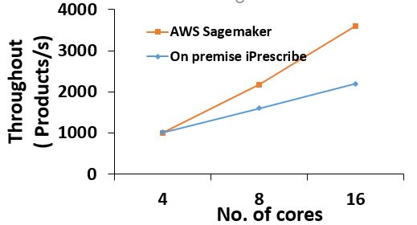
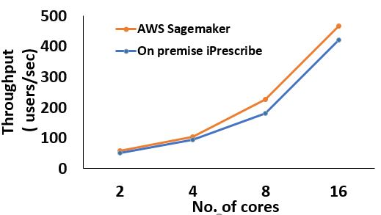
On-Premise vs AWS Sagemaker
Throughput comparison
Instacart
PAKDD
Better throughput observed in AWS Sagemaker due to optimization and scaling

Slide 15
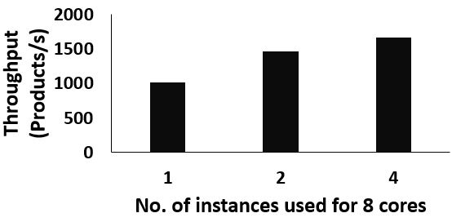
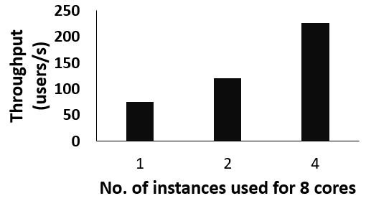
No. of instances vs throughput
Instacart
PAKDD
Throughput of the recommendation system increases as we increase the number of instances while keeping the total number of cores same

Slide 16
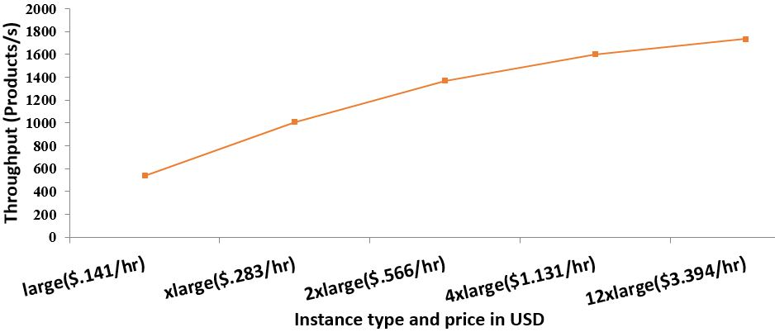
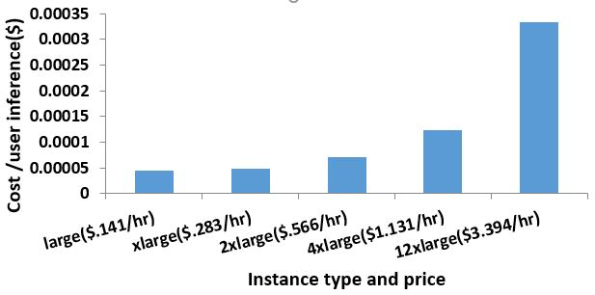
Throughput and cost per inference
instacart
Throughput on difference instance types
Cost per inference on different instance types

Slide 17
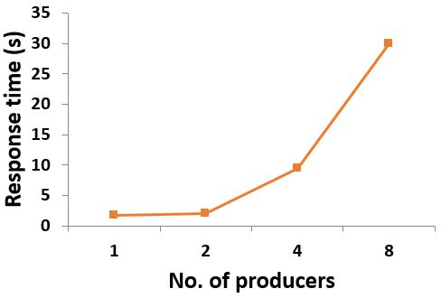
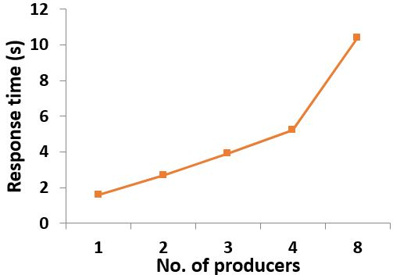
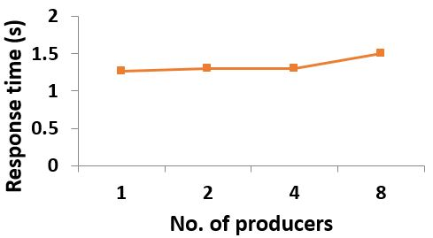
Response time with Network bandwidth
low network band width (5Gb/s)
low-mid network bandwidth(10 Gb/s)
High network bandwidth ( 25Gb/s)

Slide 18
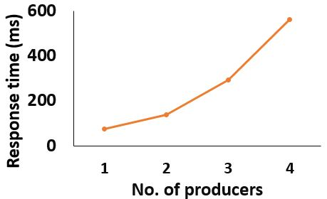
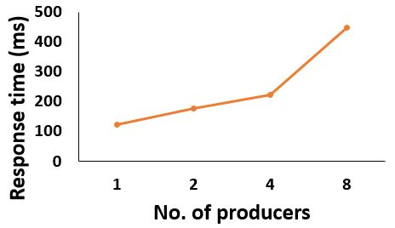
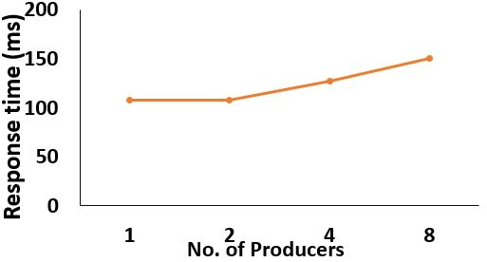
Response time with Network bandwidth
low network band width (5Gb/s)
low-mid network bandwidth(10 Gb/s)
High network bandwidth ( 25Gb/s)

Slide 19
Conclusion
We have successfully migrated in-house deployment of recommendations system to cloud using AWS Sagemaker
AWS Sagemaker performance better than the on-premise deployment
The choice of instance affects the cost and performance metrics like throughput and latency.

Slide 20
Thank You
For any Queries feel free to reach us at
Dheeraj chahal (d.chahal@tcs.com)
Ravi Ojha(ravi.ojha@tcs.com)

